Slide 1
Transmission impairments
Signals travel through transmission media which are not perfect.
imperfection causes signal impairment.
signal at the beginning of the medium is not the same as the signal at the end of the medium.
Three main reason for transmission Impairments are
Attenuation
Distortion
Noise

Slide 2
Attenuation – loss of energy.
strength of signal decreases with increasing distance which causes loss of energy in overcoming resistance of medium.
Amplifiers are used to amplify the attenuated signal which gives the original signal back and compensate for this loss.
Distortion – changes in the form or shape of the signal.
Generally seen in composite signals made up with different frequencies. Each frequency component has its own propagation speed travelling through a medium.
thats why there is different delay in arriving at the final destination.
Every component arrive at different time which leads to distortion.
Equalizer can be used to avoid distortion. ( equalizer is a filter at the receiver whose frequency response is inverse of the channel frequency response.

Slide 3
Noise - random or unwanted signal that mixes up with the original signal is called noise.
Thermal noise is due to random movement of electrons in wire due thermal excitation and creates an extra signal.
Crosstalk noise is when one wire affects the other wire. Or between antenna whose frequency band are close.
Impulse noise is a signal with high energy that comes from lightning or power lines
Noise reduces the SNR value.
Noise effect can be reduced by using :
Matched filter used to increase the SNR of received signal.
A filter in signal processor that allows only desired frequencies while filtering out other frequencies.
Channel Coding ( error detection and correction)
Diversity ( MIMO)

Slide 4
Signal and system
Signal is a physical quantity that varies with time, space, or any other independent variable by which information can be conveyed.
Basically it is a carrier of data.
It is also electrical, optical or electromagnetic wave representation of data.
Types
Analog signal
Digital signal
System is a set of elements which are connected together and generates an output signal corresponding to an input signal
The output or response of the system depends upon the transfer function of the system.
Types
Continuous-Time Systems
Discrete-Time Systems

Slide 5
Discrete and Continuous time signal
Continuous time signal defined by continuous wave pattern change over period of time.
Signal is defined at every instant of time.
Signal is defined in amplitude, frequency and phase form.
X(t)=A cos(wt + φ) w= 2π/T
Discrete signal is defined by train of periodic impulse with different amplitude.
Signal are defined by sample amplitude.
X[n]=A cos(wn + φ) w= 2π/N, N is number of sample in in a time period.

Slide 6
Periodic and Non‐periodic Signals
Periodic signal has a definite pattern and repeats itself at a regular interval of time ie time period T
continuous time signal x(t) is periodic if
𝑥(𝑡 + 𝑇) = 𝑥(𝑡)
discrete-time signal x(n) is periodic if
𝑥(𝑛) = 𝑥(𝑛 + 𝑁); for all integers 𝑛 N is number of sample in a time period.
A signal is considered to be non-periodic or aperiodic signal when it does not repeat its pattern over a period.

Slide 7
Condition of periodicity for discrete time signal
x[n] = x[n + N]
A cos(wn + φ) = A cos(w(n + N) + φ)
A cos(wn + φ + 2πk) = A cos(wn + φ + wN)
2πk = wN k=0,1,2,3,4...
w = 2πk/N here both k and N are integer, hence w should be rational multiple of 2π.
For composite signal ( for both discrete and continious signal) the ratio of frequency of composite signal should be rational.

Slide 8
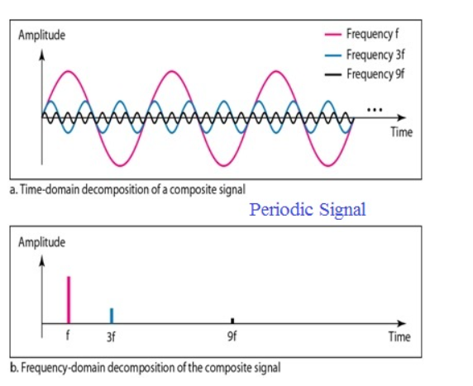
Fundamental Frequency: lowest frequency component present in a periodic composite signal. Other higher frequency component which are integer multiple of fundamental is its harmonics.

Slide 9
Deterministic and Random Signals
A signal is said to be Random if there is uncertainty in its value at every instant of time.
Signal which cannot be described by any mathematical expression is called as a random signal.
Impossible to predict the signal by observing its past behavior.
Noise in the communication is random signal.
Deterministic signal can be defined by mathematical term.
Here future signal behavior can be predicted.
can be described by any mathematical expression

Slide 10

Energy signal
Energy signal has finite energy and a zero power
If the amplitude of a signal is zero as the function tends to infinity at time (t) the, that signal is an energy signal
Non-periodic signals are energy signals
Finite duration pulse or decaying exponents are energy signal.
discrete time signal that converges is an energy signal but if it diverges, it is not an energy signal.
For real CT and DT signal, energy is calculated

Slide 11

Power signal
Power Signal
Power signal has finite power and has an infinite energy
If the amplitude of a signal is constant as the function tends to infinity at time (t) the, that signal is a power signal
Periodic signals are power signals.
For real CT and DT signal, power is calculated

Slide 12
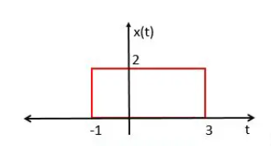
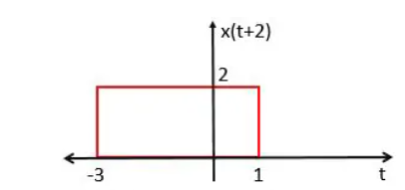
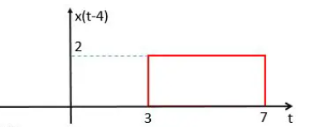
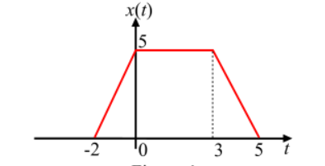
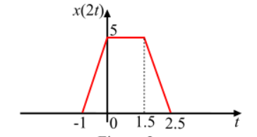
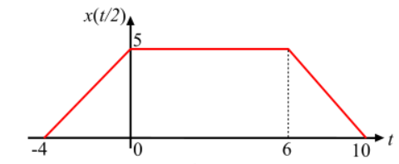
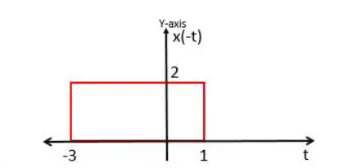
Time Shifting and scaling

Slide 13
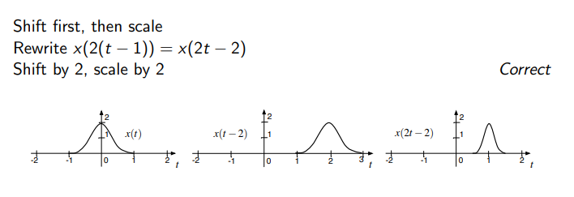
shifting and scaling

Slide 14
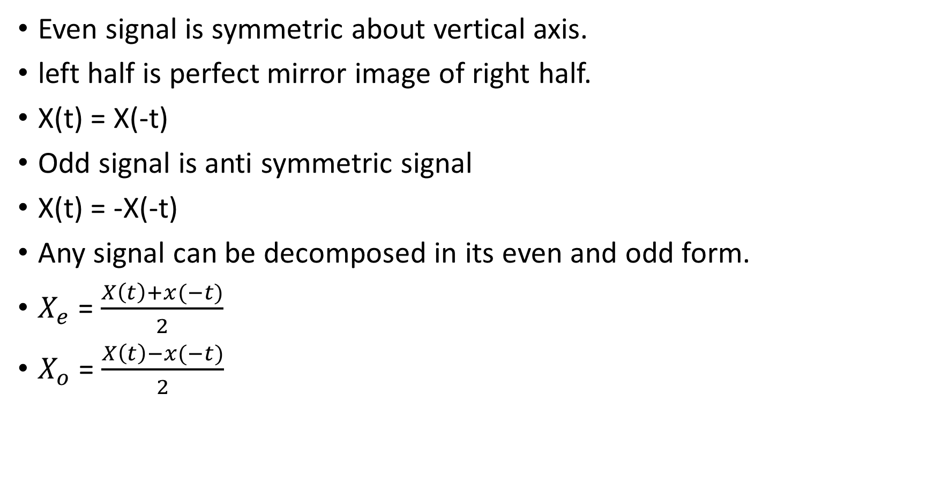
Even and odd signal
Even signal is symmetric about vertical axis.
left half is perfect mirror image of right half.
X(t) = X(-t)
Odd signal is anti symmetric signal
X(t) = -X(-t)
Any signal can be decomposed in its even and odd form.
$X_{e}$ = $\frac{X\left(t\right)+x(−t)}{2}$
$X_{o}$ = $\frac{X\left(t\right)−x(−t)}{2}$

Slide 15
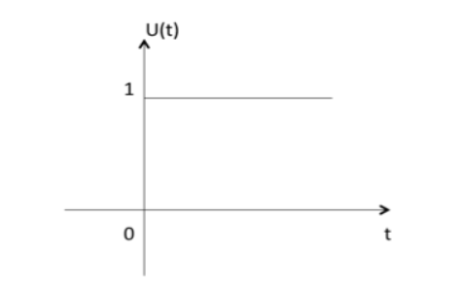
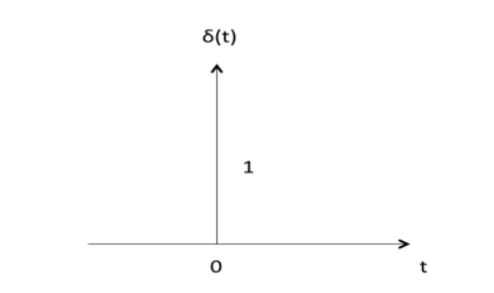
Unit step and impulse signal
Signal u(t) is said to be unit-step signal if
u(t) = 1 for t≥0
= 0 t<0
u(n) = 1 for n≥0
= 0 n<0
Signal u(t) is said to be impulse signal if
δ(t) = 1 for t=0
= 0 t!=0
δ(n) = 1 for n=0
= 0 n!=0

Slide 16
Memoryless and memory system. Static and dynamic system
A system is memoryless if its output at a given time is dependent only on the input at that same time,
y(t)= Kx(t) + x(t)
memoryless system does not have memory to store any input values.
Independent of the input at times before or after t.
Memory system output depends on past or future input and it has a memory delay or prediction system.
Y(t)= x(t-1)+ 2x(t-3) + x(t+1)
Check memory or memoryless?
y(t)=x(3t) (M) y(t)=x(cost)(M) y(t)=3x(t) (ML) y(t)=cos(x(t))(ML)

Slide 17
Time invariance and variant system
A time-invariant system is one whose behavior (its response to inputs) does not change with time.
if the input and output characteristics of a system do not change with time,
Any delay provided in the input must be reflected in the output for a time invariant system.
Y(t-ᴦ) = X(t- ᴦ)
A system whose input and output characteristics change with the time is known as time-variant system.
the delay observed on output of the system is not equal to delay made in input of system.
𝑦(𝑡- 𝑡₀) ≠ x(𝑡 − 𝑡₀)

Slide 18
Linear and Non-linear System.
Linear system satisfies principal of homogeneity and superposition.
If y(t)= x(t) then ay(t)= ax(t) (homogeneity)
𝑦₁(𝑡) = 𝑥₁(𝑡) and 𝑦₂(𝑡) = 𝑥₂(𝑡)
[𝑦₁(𝑡) + 𝑦₂(𝑡)] = [𝑥₁(𝑡) + 𝑥₂(𝑡)] (superposition)
system is linear if weighted sum of inputs produces corresponding weighted sum of outputs.
a₁ 𝑦₁(𝑡) + a₂𝑦₂(𝑡)] = [a₁ 𝑥₁(𝑡) + a₂ 𝑥₂(𝑡)]
A system is said to be a non-linear system if it does not obey the principle of homogeneity and principle of superposition.

Slide 19
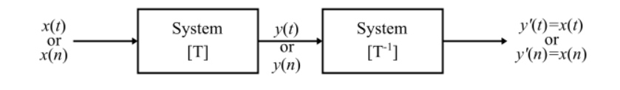
Invertible System
One to one mapping between input and output, ie unique relation between I/O.
a system is said to be an invertible system only if an inverse system exists which when cascaded with the original system produces an output equal to the input of the first system.
Non-Invertible System
If there is many to one mapping between input and output at any given instant for system, then the system is known as non-invertible system.
𝑦(𝑡) = 5𝑥(𝑡) 𝑦(𝑡) = 5𝑥²(𝑡) check invertible or non invertible system?

Slide 20
Causal and non causal system
Causal system: output depends on past and current inputs but not future inputs.
Output y(t) depends on only on input x(t) for t≥0
Y(t)=ax(t)+bx(t-ᴦ)
Causal signals are physically realizable, since they only depend on past and present values of time that can be measured and recorded.
Non causal system: output depends on past, future and current inputs.
Y(t)=ax(t)+bx(t-ᴦ)+cx(t+ᴦ)
Anticasal syetem: output depends only on future input.
Y(t)=cx(t+ᴦ)

Slide 21
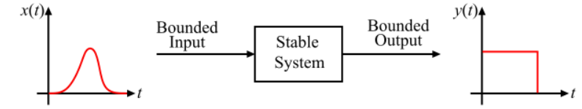
Stable and unstable system
Stable System or BIBO Stable System: if and only if every bounded input produces a bounded output.
The output of a stable system does not diverse.
If the impulse response of the system is absolutely integrable or absolutely summable, then the system is a stable system.
Y(t)=sinx(t) for x(t) ≤ 6

Slide 22
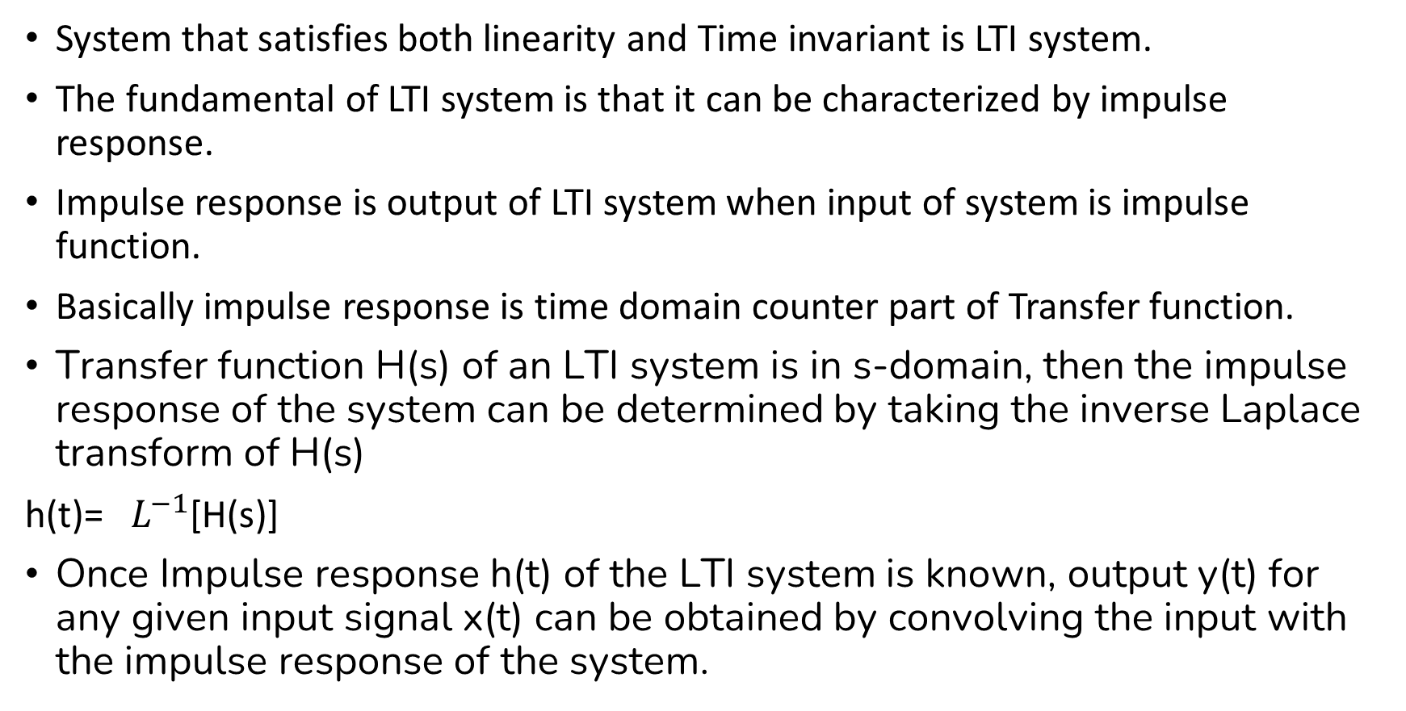
LTI system and impulse response
System that satisfies both linearity and Time invariant is LTI system.
The fundamental of LTI system is that it can be characterized by impulse response.
Impulse response is output of LTI system when input of system is impulse function.
Basically impulse response is time domain counter part of Transfer function.
Transfer function H(s) of an LTI system is in s-domain, then the impulse response of the system can be determined by taking the inverse Laplace transform of H(s)
h(t)=${ L}^{−1}$[H(s)]
Once Impulse response h(t) of the LTI system is known, output y(t) for any given input signal x(t) can be obtained by convolving the input with the impulse response of the system.

Slide 23
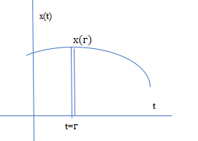
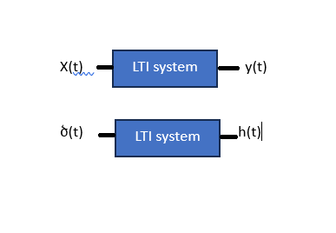
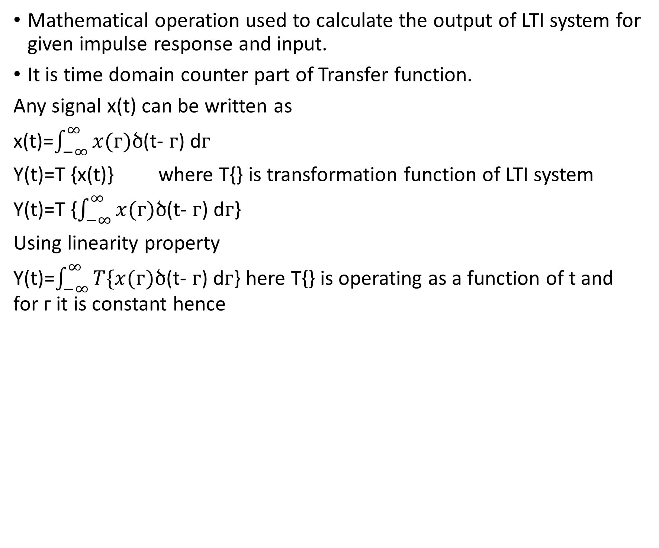
Convolution
Mathematical operation used to calculate the output of LTI system for given impulse response and input.
It is time domain counter part of Transfer function.
Any signal x(t) can be written as
x(t)=$\int_{−∞}^{∞}{x(ᴦ})ծ$(t- $ᴦ$) d$ᴦ$
Y(t)=T {x(t)} where T{} is transformation function of LTI system
Y(t)=T {$\int_{−∞}^{∞}{x(ᴦ})ծ$(t- $ᴦ$) d$ᴦ$}
Using linearity property
Y(t)=$\int_{−∞}^{∞}{T\{x(ᴦ})ծ$(t- $ᴦ$) d$ᴦ$} here T{} is operating as a function of t and for ᴦ it is constant hence

Slide 24

Y(t)=$\int_{−∞}^{∞}{x(ᴦ}) T\{ծ$(t- $ᴦ$) d$ᴦ$}
$since T\{ծ$(t- $ᴦ$)} = $h$(t- $ᴦ$)
Y(t)=$\int_{−∞}^{∞}{x(ᴦ})h$(t- $ᴦ$) d$ᴦ$
Similarly discrete LTI system
y[n] = $\sum_{k=−∞}^{∞}{x\left(k\right)h(n−K)}$

Slide 25
Fourier series and Fourier Transform.
Fourier series decompose a periodic signal into a sum of sine and cosine terms with different amplitude and freq.
Smallest frequency is fundamental freq. and other integer multiple are its harmonics.
Fourier Transform is a mathematical operation for converting a signal from time domain into its frequency domain.
Fourier Transform are especially for Aperiodic signal that gives continuous frequency distribution.
Periodic signal has discrete frequency distribution where as Aperiodic signal has continuous frequency distribution.

Slide 27
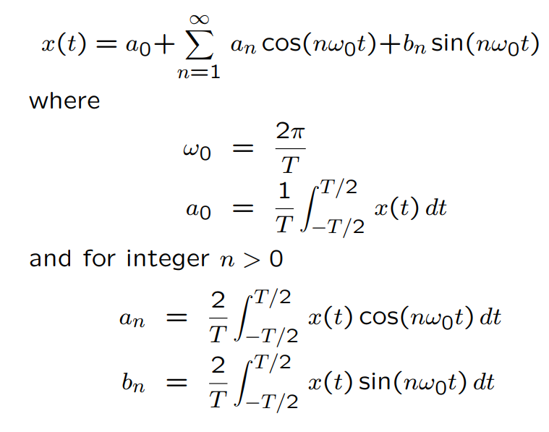
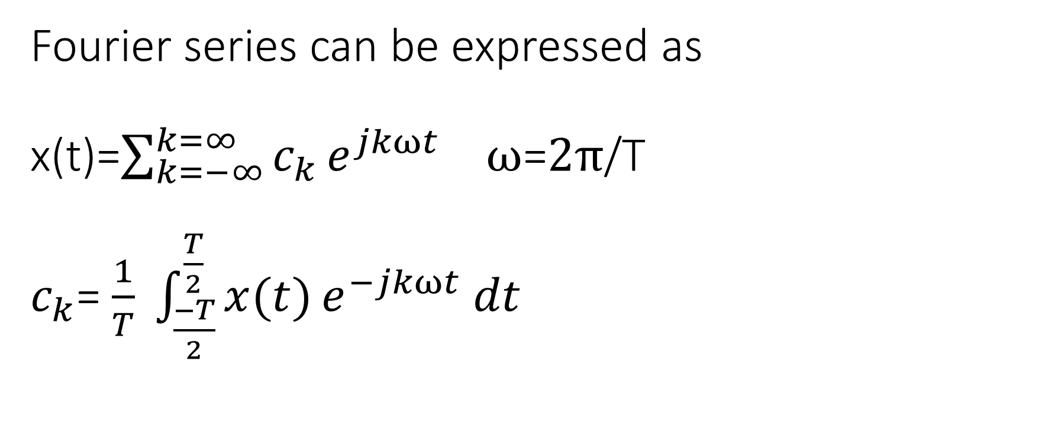
Fourier series can be expressed as x(t)=$\sum_{k=−∞}^{k=∞}{c_{k}}e^{jkωt}$ $ω$=$2π$/T $c_{k}$= $\frac{1}{T} \int_{\frac{−T}{2}}^{\frac{T}{2}}{x(t)}e^{−jkωt} dt$

Slide 28
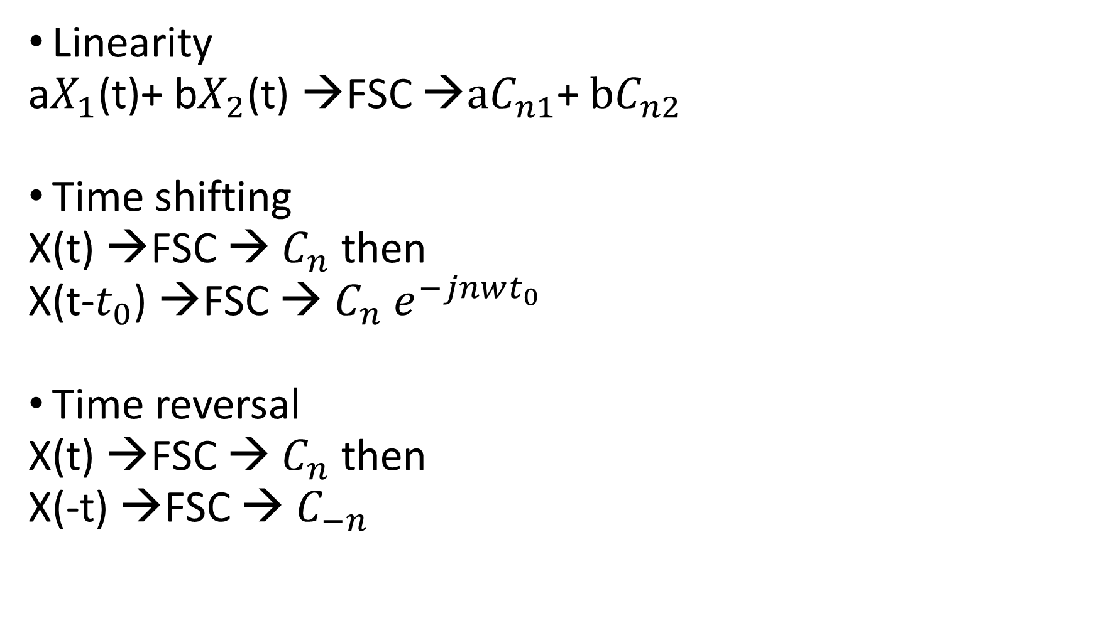
Properties of Fourier series
Linearity
a$X_{1}$(t)+ b$X_{2}$(t) →FSC →$aC_{n1}$+ $bC_{n2}$
Time shifting
X(t) →FSC → $C_{n}$ then
X(t-$t_{0}$) →FSC → $C_{n} e^{−jnwt_{0}}$
Time reversal
X(t) →FSC → $C_{n}$ then
X(-t) →FSC → $C_{−n}$

Slide 29
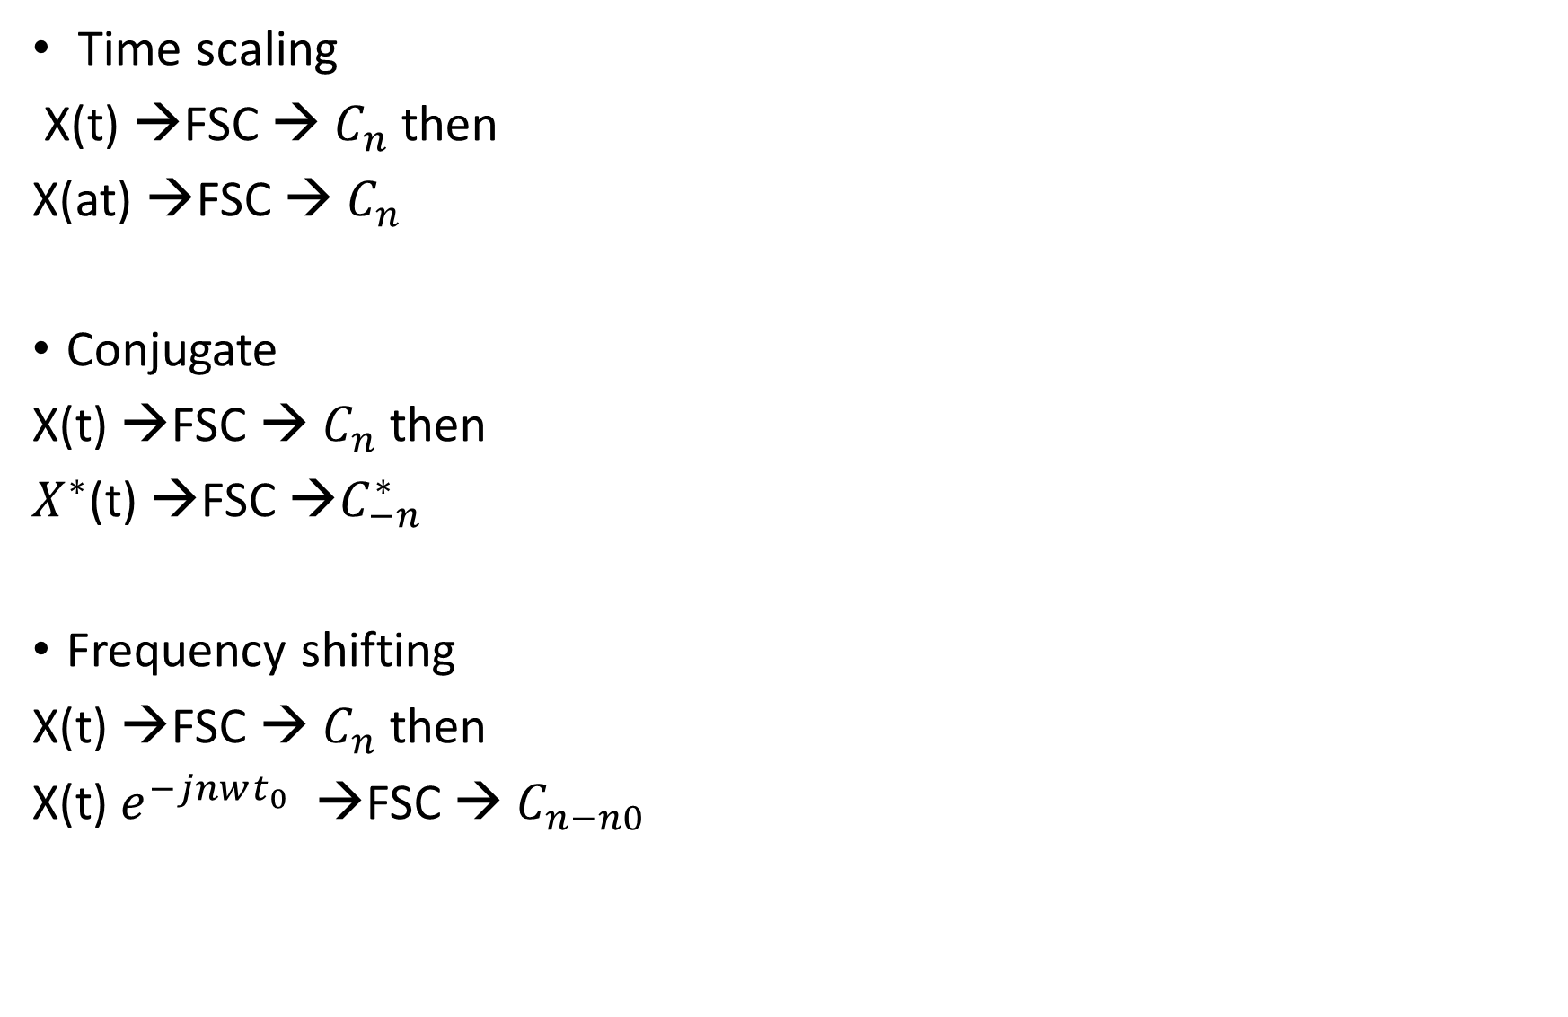
Time scaling
X(t) →FSC → $C_{n}$ then
X(at) →FSC → $C_{n}$
Conjugate
X(t) →FSC → $C_{n}$ then
$X^{∗}$(t) →FSC →$C_{−n}^{∗}$
Frequency shifting
X(t) →FSC → $C_{n}$ then
X(t) $e^{−jnwt_{0}}$ →FSC → $C_{n−n0}$

Slide 30
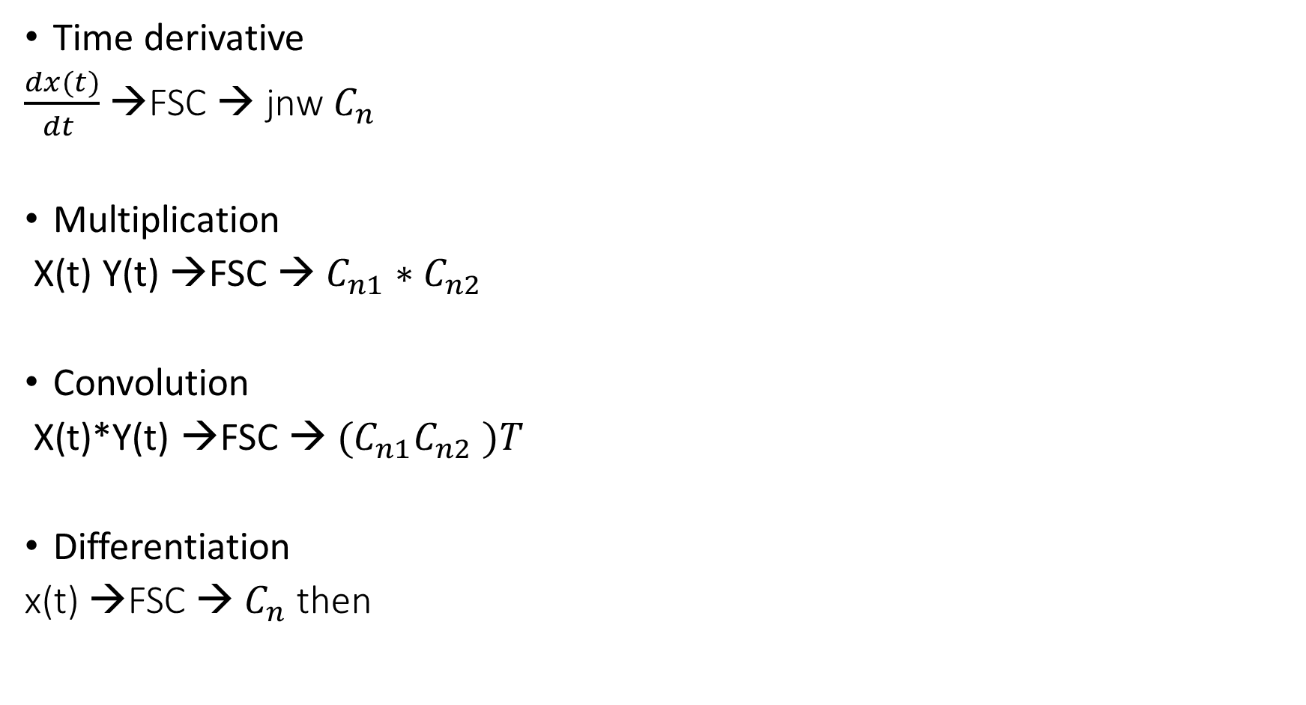
Time derivative
$\frac{dx(t)}{dt }$ →FSC → jnw $C_{n}$
Multiplication
X(t) Y(t) →FSC → $C_{n1}∗C_{n2}$
Convolution
X(t)*Y(t) →FSC → ${(C}_{n1}C_{n2} )T$
Differentiation
x(t) →FSC → $C_{n}$ then

Slide 31
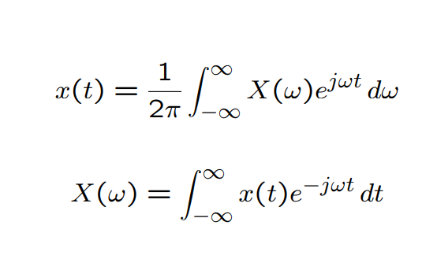
Fourier transform can be expressed as

Slide 32
Properties of the Fourier Transform
Linearity:
Time Shifting
Time Scaling:

Slide 33
Time Reversal:
Frequency shifting
Multiplication
Convolution

Slide 34
Multiplication by a Sinusoid (Modulation):
Differentiation in the Time Domain:
Duality:

Slide 35
Spectral analysis of signal
The process of determining the frequency contents of a time domain signal.
the main objective of spectral analysis is the determination of the power spectrum density (PSD)
It involves decomposing a signal into its constituent frequencies and analyzing their magnitudes, phases, and other characteristics.
it quantifies the distribution of the total power as a function of frequency.
Spectrum analyzer hardware device that measures the magnitude of an input signal versus frequency.
most commonly used techniques is the Fourier transform. The Fourier transform allows a signal to be expressed as a sum of sine and cosine functions of different frequencies
Spectral analysis is widely used in various fields, including telecommunications, audio processing, image processing, and vibration analysis(resonant frequency).

